Slide 1
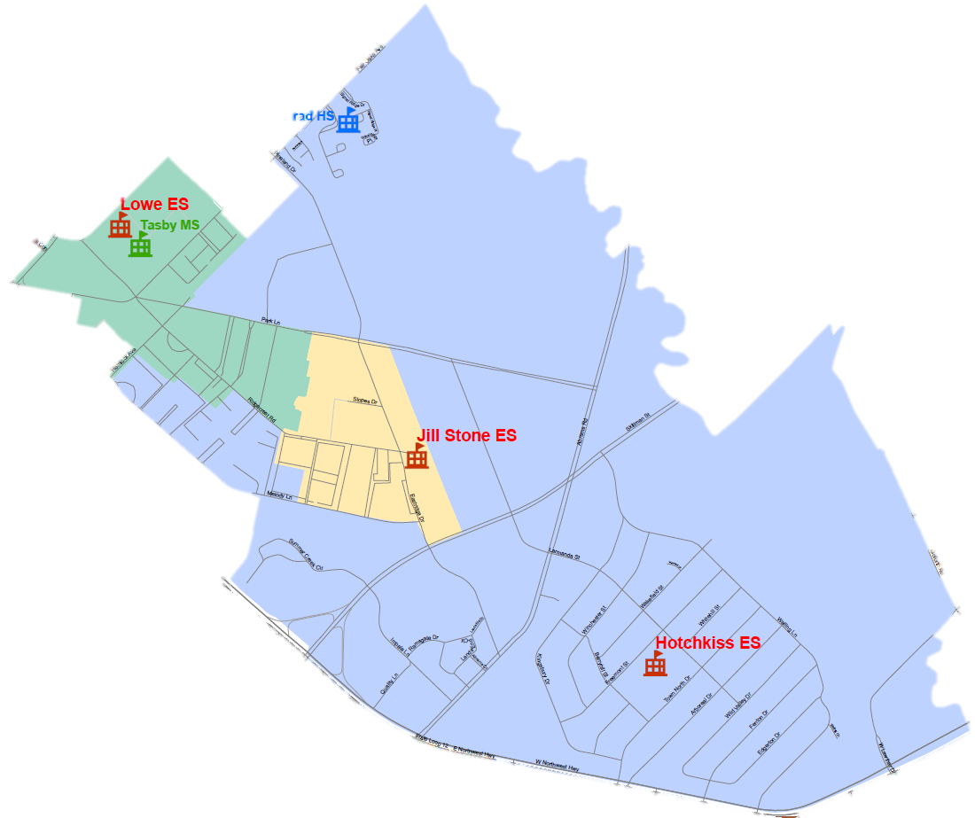

Current Boundaries
Conrad
>>>>>>>>>>>>>>>>
>>>>>>GREEN>>>>>>>>>>>>>>>>>>>>>>>SPACE>>>>>>>>>>>>>>>>>>>>>>>>>>>>>>>>> >>>>>>>>>>>>>>>>>>>>>>>>>
Hemlock Ave.
Park Lane
New School
Hotchkiss
Jill Stone
Lowe
>>>>>>>>>>>>>>>>
>>>>>>GREEN>>>>>>>> >>>>>>>>SPACE>>>>>>>
>>>>>>>>>>>>>>>>>>>>>
>>>>>>>>>>>>>>>>
Skillman
Abrams
SCHOOL LEADERSHIP
10
Northwest Hwy
Notes:
District photos can be found here: https://www.flickr.com/photos/dallas_isd/

Slide 2
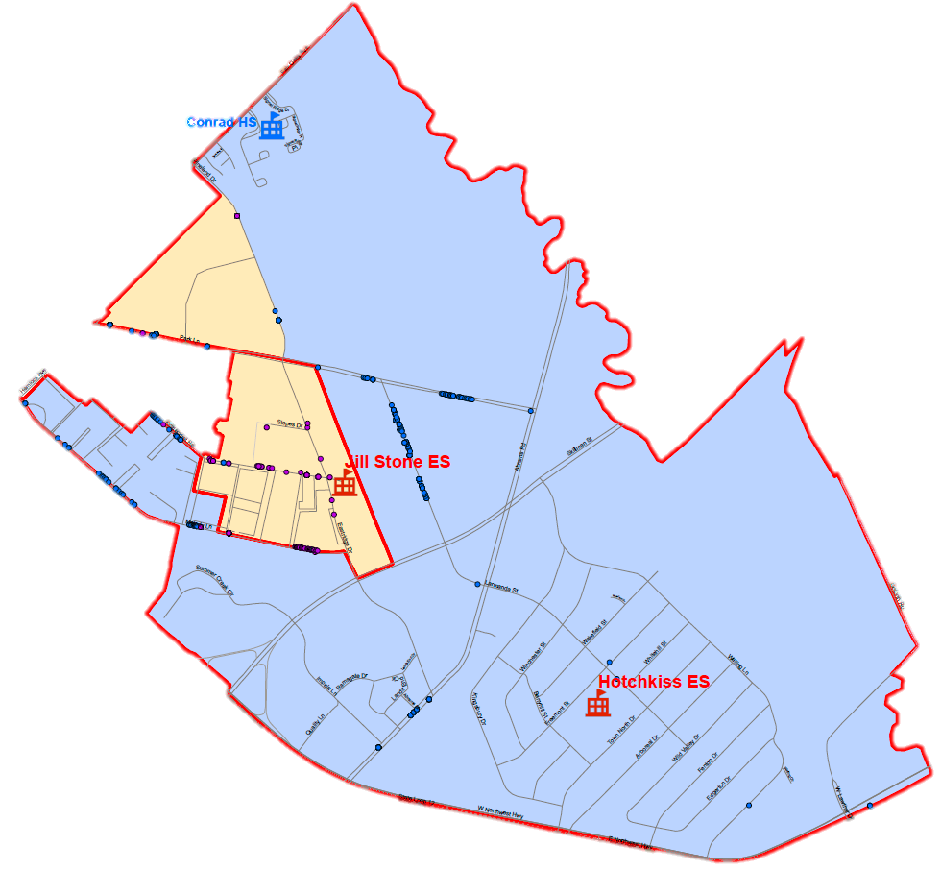
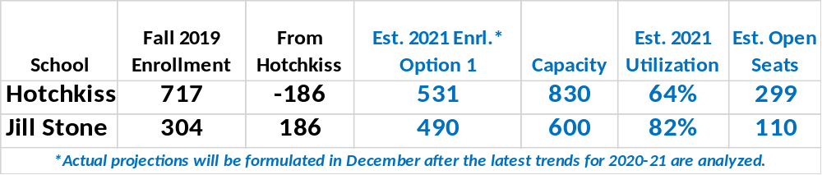
Boundary Planning – Option 1
Stone - hotchkiss
The least amount of students are impacted
>>>>>>>>>>>>>>>>
>>>>>>GREEN>>>>>>>>>>>>>>>>>>>>>>>SPACE>>>>>>>>>>>>>>>>>>>>>>>>>>>>>>>>> >>>>>>>>>>>>>>>>>>>>>>>>>
Wildflower, Woodglen, and Woods on Park Lane are rezoned from Hotchkiss to the New Jill Stone
New School
>>>>>>>>>>>>>>>>
>>>>>>GREEN>>>>>>>> >>>>>>>>SPACE>>>>>>>
>>>>>>>>>>>>>>>>>>>>>
>>>>>>>>>>>>>>>>
12
SCHOOL LEADERSHIP
Notes:
District photos can be found here: https://www.flickr.com/photos/dallas_isd/

Slide 3
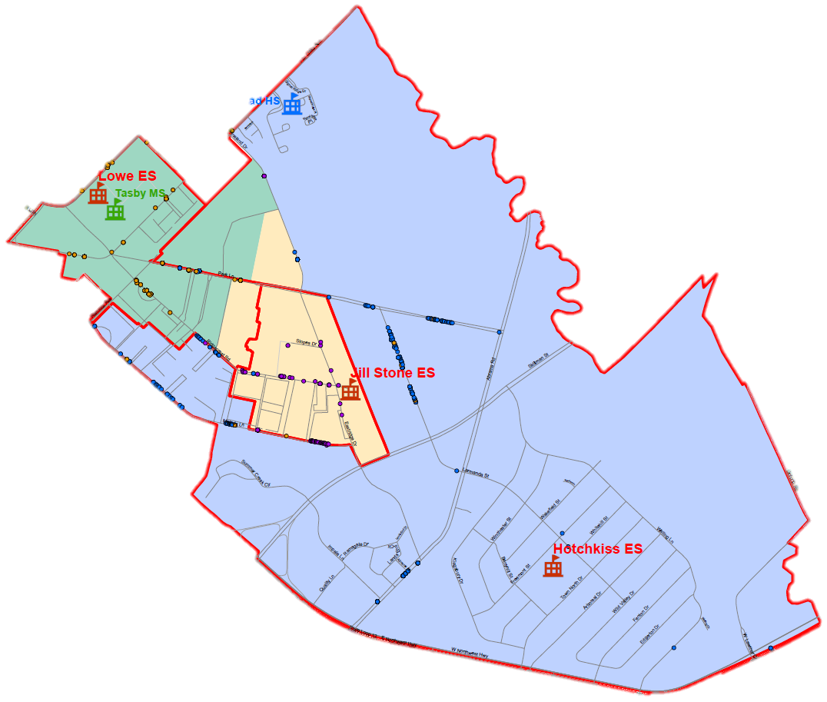
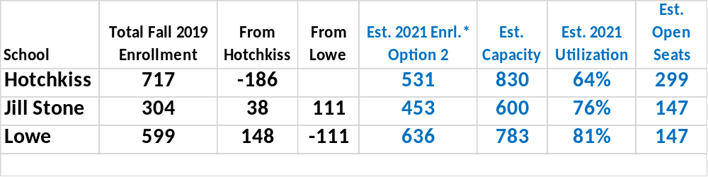
Boundary planning – Option 2
STONe – Hotchkiss - Lowe
Students living closest to the new Jill Stone campus are rezoned there.
Conrad
Wildflower is rezoned from Hotchkiss to Lowe
Woodglen, and Woods on Park Lane are rezoned from Hotchkiss to the New Jill Stone
Towne Center is rezoned from Lowe to the New Jill Stone
>>>>>>>>>>>>>>>>
>>>>>>GREEN>>>>>>>>>>>>>>>>>>>>>>>SPACE>>>>>>>>>>>>>>>>>>>>>>>>>>>>>>>>> >>>>>>>>>>>>>>>>>>>>>>>>>
Hemlock Ave.
Park Lane
New School
>>>>>>>>>>>>>>>>
>>>>>>GREEN>>>>>>>> >>>>>>>>SPACE>>>>>>>
>>>>>>>>>>>>>>>>>>>>>
>>>>>>>>>>>>>>>>
Skillman
Abrams
13
SCHOOL LEADERSHIP
Northwest Hwy
Notes:
District photos can be found here: https://www.flickr.com/photos/dallas_isd/

Slide 4
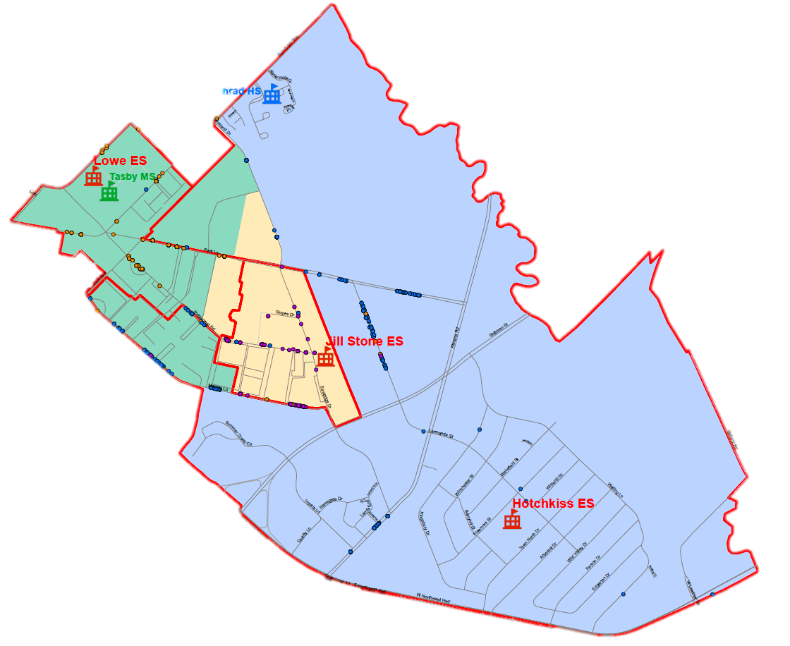
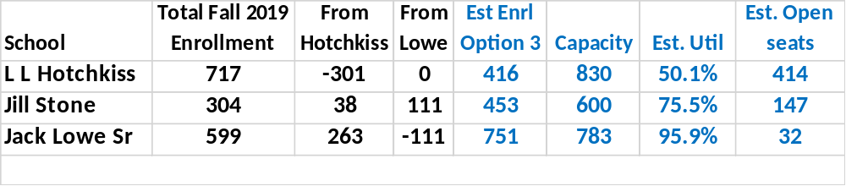
Boundary planning – Option 3
STONe – Hotchkiss - Lowe
More students are zoned within walking distance to a school
Conrad
>>>>>>>>>>>>>>>>
>>>>>>GREEN>>>>>>>>>>>>>>>>>>>>>>>SPACE>>>>>>>>>>>>>>>>>>>>>>>>>>>>>>>>> >>>>>>>>>>>>>>>>>>>>>>>>>
Same as Option 2
PLUS, Three Fountains, Princeton Courts, Biltmore, and Santa Fe Trails (Melody Ln.) are rezoned from Hotchkiss to Lowe
Hemlock Ave.
Park Lane
New School
>>>>>>>>>>>>>>>>
>>>>>>GREEN>>>>>>>> >>>>>>>>SPACE>>>>>>>
>>>>>>>>>>>>>>>>>>>>>
>>>>>>>>>>>>>>>>
Skillman
Abrams
14
SCHOOL LEADERSHIP
Northwest Hwy
Notes:
District photos can be found here: https://www.flickr.com/photos/dallas_isd/

Slide 5
Apartment Complexes Impacted | NEW Jill Stone PK-5 | L.L. Hotchkiss PK-8 Innovation | Jack Lowe, Sr. PK-5 Innovation
OPTION 1
Wildflower, Woodglen, Woods on Park Lane | ✓ | ◙
OPTION 2
Woodglen, Woods on Park Lane | ✓ | ◙
Wildflower |  | ◙ | ✓
Towne Center | ✓ |  | ◙
OPTION 3
Woodglen, Woods on Park Lane | ✓ | ◙
Wildflower |  | ◙ | ✓
Towne Center | ✓ |  | ◙
Three Fountains, Princeton Courts, Biltmore, Santa Fe Trails (Melody Ln.) |  | ◙ | ✓
Summary of Options:
◙ Zoned OUT
✓ Zoned INTO
Apartment complexes and neighborhoods not listed will not be impacted.
The current Jill Stone attendance zone will remain zoned to the new campus.
15
SCHOOL LEADERSHIP
Notes:
District photos can be found here: https://www.flickr.com/photos/dallas_isd/

